Slide 1

DALEBRO Sourcing Distribution & Consulting
www.dalebro.com

Slide 2
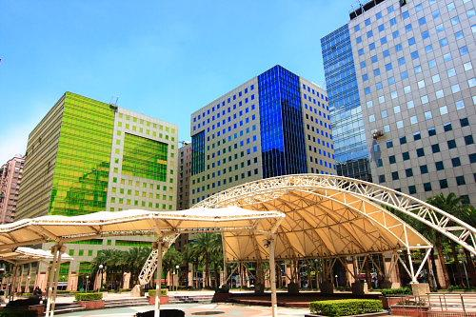
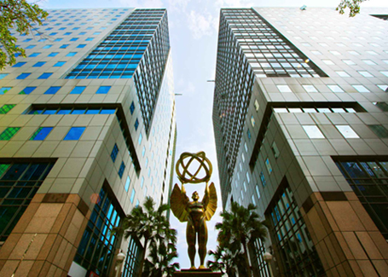
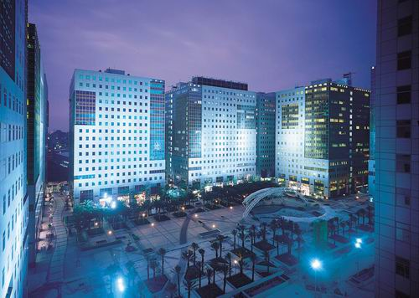
COMPANY PROFILE
About us
DALEBRO WORLDWIDE LIMITED is a Taiwanese company specialized in sourcing services, distribution of products from different industries and consulting services for the Latin American market. We focus particularly on this area due to the huge potential and existing growth. With more than 10 years of experience and with a trained professional team, we also provide consulting services for the development of new business or establishment of industrial factories.
Vision & mission
Our vision is to become the customer’s eyes and hands in Asia, minimizing their risks and maximizing their profits. We seek to consolidate as a leader par excellence, always providing value-added services at each stage of work.
Photo: Business Complex where Dalebro office in Taipei is located.
OUR OFFICES
Since we first started operations in 2003, we have strategically opened offices in Asia and Latin America:
TAIPEI OFFICE HEADQUARTER
MIAMI OFFICE
GUANGZHOU OFFICE
The headquarter established in Taipei, has a consultant team, financial team and logistic team.
Staying closer to our customers to provide an immediate response.
For managing the relationship with suppliers and quality control of products.
www.dalebro.com

Slide 3
WHY CHOOSE DALEBRO
TANGIBLE
RESOURCES
INTANGIBLE
BENEFITS
Offices in different
continents
High mobility
and immediate response
BENEFITS
We can speak Spanish, Chinese and English
No communication barriers
- High performance
- Increase in profits
- One step ahead of the competition
We have material, knowledge and human resources
We provide value-added services
- Reduce cost
- Decrease in operations
- Decrease in time and delays
Professionals with experience in the industry
Effective implementation of strategies and procedures
RISKS
www.dalebro.com

Slide 4


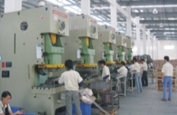
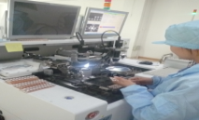
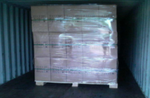

VALUE CHAIN
INDUSTRY ANALISYS
Market research, search for product and manufacturers.
Our value
In each link of the chain of work you can appreciate Dalebro value-added services that we offer to ours customers. We coordinate and supervise in detail all process and operations in the supply chain:
PLANIFICATION
Planning and defining the characteristics, quality’s parameters, prices and purchasing terms .
PRODUCTION
Outsourcing of production, BOM verification and delivery terms
QUALITY CONTROL
Supervising the production process (SOP), determine quality control criteria and standards
LOGISTICS
Coordination of logistics transportation and preparation of required documents
AFTER SERVICE
.
Monitoring of RMA cases and assisting with customer’s consultations
www.dalebro.com

Slide 5
SERVICE - SOURCING
Dalebro – LEADER in SOURCING SERVICES
China has become the manufacturing center of the world, with thousands of factories producing a wide variety of consumer products. Dalebro gives support to companies for handling international procurement especially in Asia. As your sourcing agent we not only take care of finding the product with the desired quality but also the verification of reliable manufacturers in order to establish a long term business relationship between manufacturer and customer.
CIRCLE OF BENEFITS
Production Control
Inspection and quality control
Prices and purchasing terms negotiations
One Stop Shop
Logistics Services
DALEBRO
Search of factories and product services
Other value-added services
CUSTOMER
One Stop Shop
We reduce operations by being a “ONE STOP SHOP” offering several services in one place.
Your office in Asia
We are your contact point in Asia, minimizing your infrastructure cost and personnel.
Team work
Customer is responsible for sales in local market, Dalebro is responsible for the operational management in Asia checking that customer’s orders meets their expectations.
www.dalebro.com
www.dalebro.com
www.dalebro.com

Slide 6

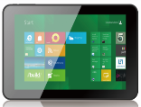






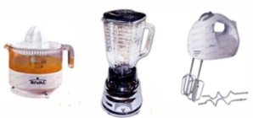
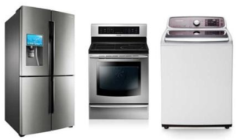


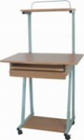
SERVICE – DISTRIBUTION
Dalebro – Excellent distributor
We are leading distributor of products manufactured in China for Latin America. Over the years we have acquired a portfolio of brands and products with trusted vendors offering good quality and competitive costs. We have the knowledge to handle the purchase process, supply chain as well as local export regulations making the job easier for our customers.
We have a porfolio of validated products where the most outstanding are:
Consumer Electronics Products
We offer customer their own brand and in all kind of forms:
Clean and Renewable Energy Products
OEM & ODM:
- Customer’s own brand
- Generic brand
Household and kitchen appliances
Products in:
- CBU: Complete Built Unit
- SKD: Semi-Knocked Down
- CKD: Complete-Knocked Down
Others
www.dalebro.com

Slide 7
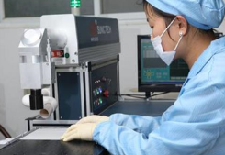
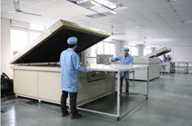
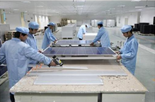
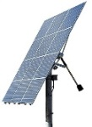
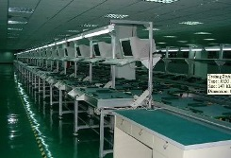
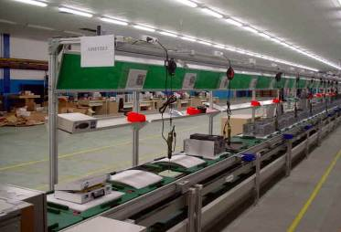
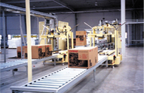

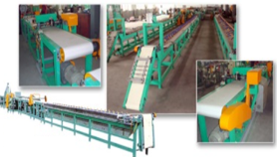
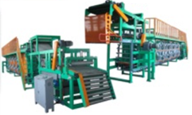
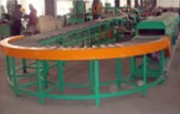
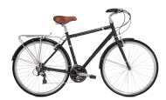
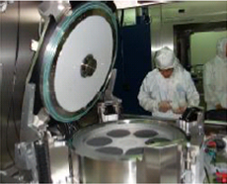

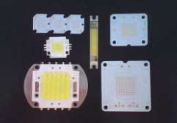

SERVICE – CONSULTING
Dalebro – turnkey solutions specialist
"Turnkey Solutions" - are engineering projects that can be designed, produced and adjusted to fit customers requirements so it can be used immediately after the delivery. Through the years, Dalebro has accumulated the knowledge, experience and resources in different areas to provide consulting services to our customers in the implementation of new technologies and production methods in their countries. We assist our customers with the transfer of knowledge, the "know-how" to enable production in the shortest time possible and more efficiently.
Successful cases implemented by Dalebro:
Production line for solar panels in Argentina
=
Assembly line for PC & notebooks in Mexico
=
Production line for bicycle inner tube in Argentina
=
Production line for LED lights in Brazil
=
www.dalebro.com

Slide 8
CONTACT US
Dalebro – Taiwan (Headquarter)
3F., No. 16, Jian 8th Rd., Zhonghe District, 235, New Taipei City, Taiwan Tel: +886-2-82263818 Fax: +886-2-82263819 Email: info@dalebro.com
Dalebro – China
No. 2, 7FL, Zhukeng Village, Panyu District, Guangzhou, Postcode: 511400, Guangdong, China Tel: +86-20-22871559 Fax: +86-20-22871663 Email: info@dalebro.com
Dalebro – Latin America
9555 SW 181st Terrace, Miami, FL33157, USA
Tel: +1-786-4448632
Email: info@dalebro.com
www.dalebro.com

